Slide 1
Zero Waste
What does it mean?
Zero waste is a philosophy that encourages the redesign of resource life cycles so that all products are reused. No trash is sent to landfills and incinerators. The process recommended is one similar to the way that resources are reused in nature.
It’s misleading, limiting, and intimidating while simultaneously striving keep a larger goal at the forefront.
“Zero Waste or Darn Close”
Any action that reduces waste reduction can be classified as contributing to the Zero Waste movement.

Slide 2
What’s Happening on Campus?
Preconsumer Waste at Dining Halls
Paper Towels
Styrofoam From Labs
Film Plastic
Redeeming Station
Lawn Clippings
Water
Zero Waste Events (encouraged)

Slide 3
Zero Waste Working Group Ideas
Improve Zero Waste Campus Events
Promoting Zero Waste Offices – eliminating single use/disposables: plasticware, cups, impact of Keurig’s, etc.
Campus Composting Initiative
Unbottle Water Campaign (be the Core Team)
Step-by-Step guide on Center For the New American Dream

Slide 6
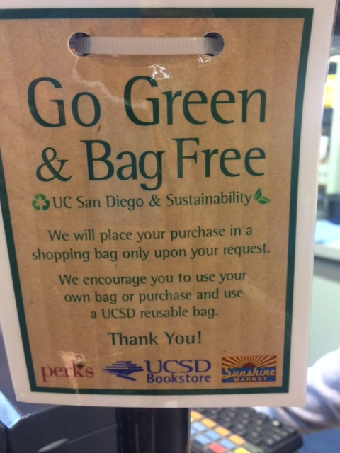

Slide 7
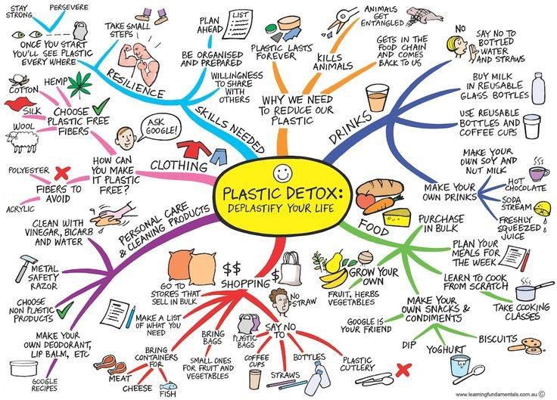

Slide 9
Resources
Center For The New American Dream
Zero Waste Home
Trash is for Tossers

